Slide 1

~Analysing and predicting valuable skills and occupations for early career programmers~
Faldi Lluri
February 2024

Slide 2

Presentation overview
Project description
Dataset and tools
Short description of the work-flow
Questions selected
Visualizations of each questions
Models used
Models comparisons
Conclusions

Slide 3
This project is more focused on the following points:
Analyze the O*NET Dataset
Apply NPL techniques on the O*NET Dataset
Develop an word embedding algorithm able to predict valuable skills and occupations for early career programmers

Slide 4




Dataset ad
Dataset and Tools
O*NET Dataset
PYTHON & JUPYTER
Data manipulation: numpy, pandas
Data Cleaning assisters: string, os modules (python)
Data visualization: matplotlib, seaborn, plotly
Text preprocessing: nltk
Models: SentenceTransformer, genism
Clustering and dimensionality reduction: sklearn
Developed and maintained by the U.S Department of Labour
Comprehensive and detailed database that contains information about various occupations and their characteristics
Selected the .xlsx format of the file
Files related to: skills, abilities, tasks, technology skills, education, work activities and knowledges.

Slide 5



Work Flow Description
Dataset familiarisation
Gather knowledge about the domain
Data pre-processing
Model(s) definition
Model Training
Model Evaluation

Slide 6
Questions
What are the key differences
between mid-level and entry
level positions?
What are the emerging skills
And technologies in the
programming field?
What non-tech skills are most
frequently needed in
programming job descriptions?

Slide 7

Question Selected
What are the key differences
between mid-level and entry
level positions?
What are the emerging skills
And technologies in the
programming field?
What non-tech skills are most
frequently needed in
programming job descriptions?

Slide 8

Question Selected
What are the key differences
between mid-level and entry
level positions?
What are the emerging skills
And technologies in the
programming field?
What non-tech skills are most
frequently needed in
programming job descriptions?

Slide 9

Question Selected
What are the key differences
between mid-level and entry
level positions?
What are the emerging skills
And technologies in the
programming field?
What non-tech skills are most
frequently needed in
programming job descriptions?

Slide 10
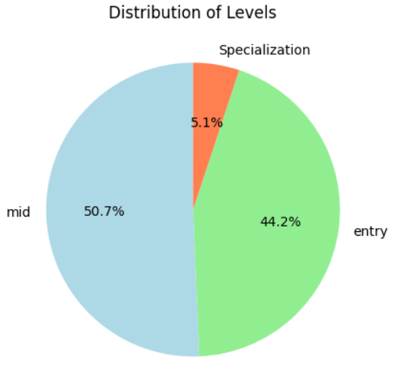
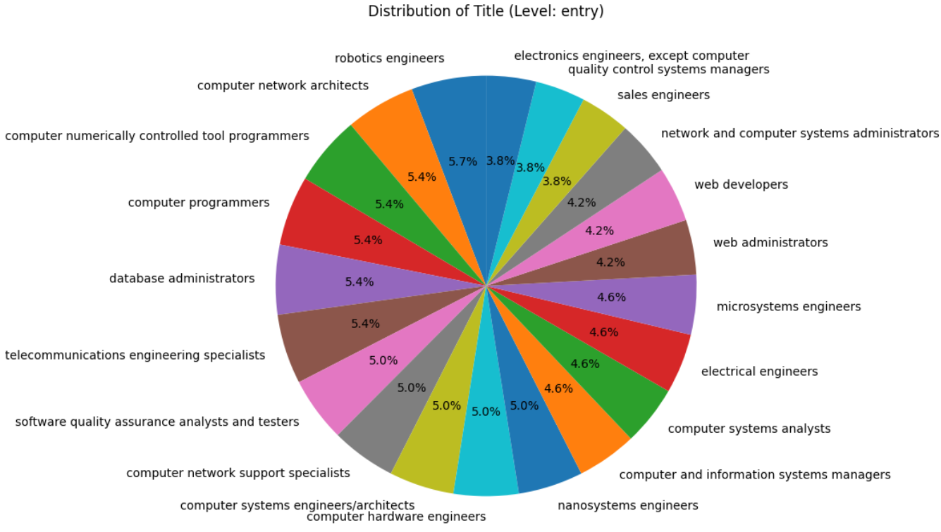
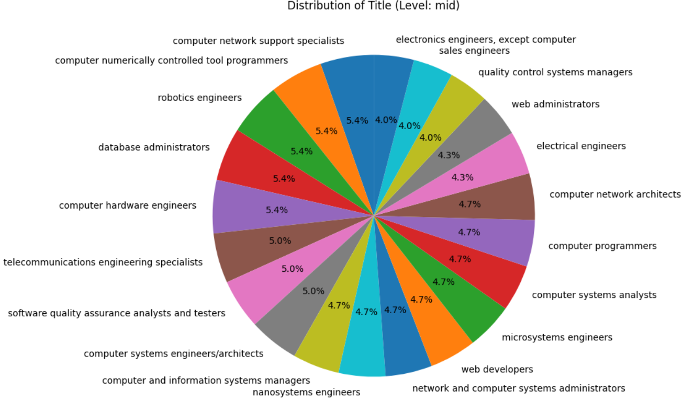
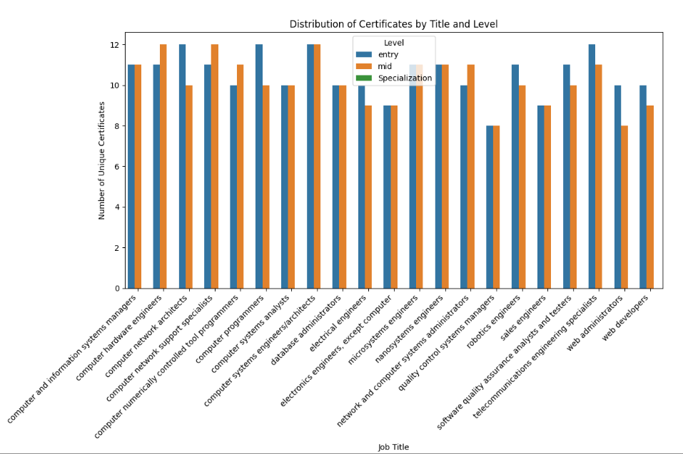

Slide 11
First question
Only for jobs related to programming field
Classification in terms of certificates, trainings and experiences
Sum up to a total of 21 jobs

Slide 12
A distribution of job titles
based on the number of mid
level recordings

Slide 13
A distribution of job titles
based on the number of entry
level recordings

Slide 14
Classifies the relevance of each certificate for a specific level in a job position

Slide 15
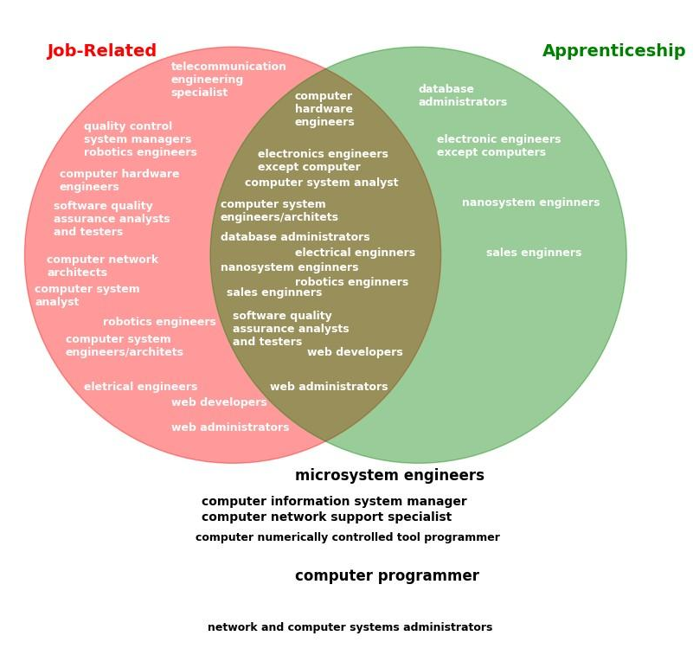
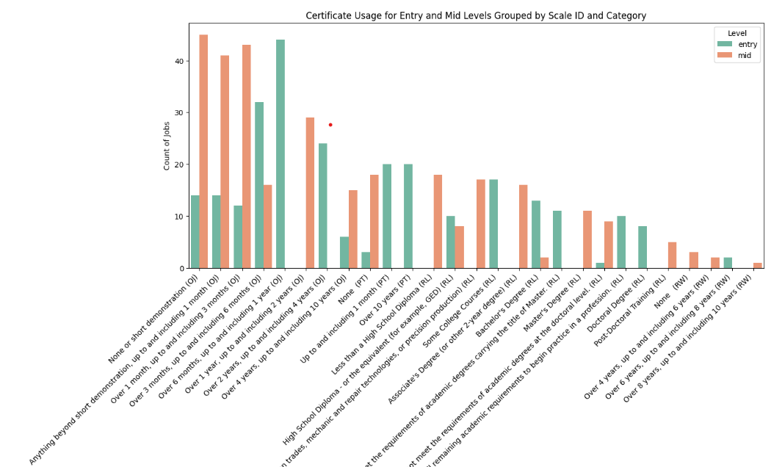

Slide 16
A visual representation of the jobs related to their specialization requests

Slide 17
Distinguishing the
Importance of each
certificate related
to job level

Slide 18


Conclusions
- Entry-level - shorter durations of on-site training, job training, and work experience
for hands-on learning.
- Mid-level roles - candidates with extensive work experience, especially durations
over one year, up to and including two years.
- Certain certifications, hold significance in both entry and mid-level roles.
- Skill-based qualifications over educational attainment in the progression from
entry to mid-level positions.

Slide 19
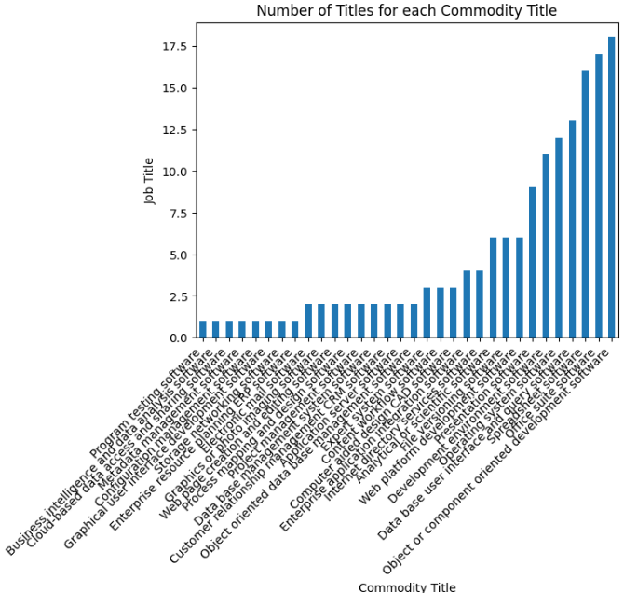
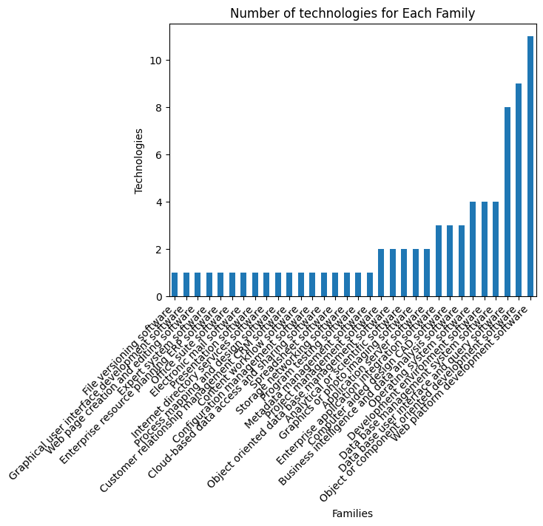

Slide 20
Second Question
A visualization of the
categories that the
emerging technologies
belong to

Slide 21
A visualization of the
distribution of
the categories
spread among job titles

Slide 22

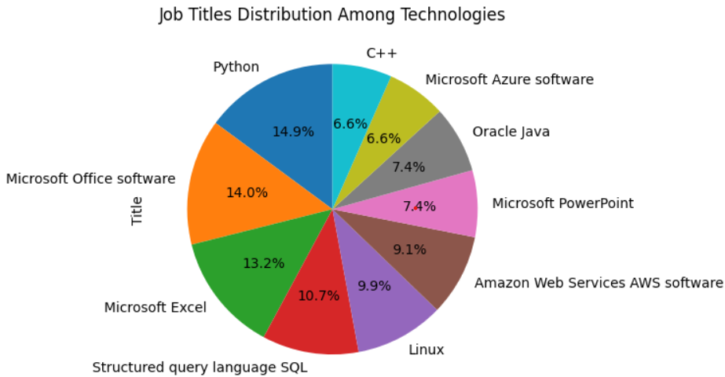
Conclusion (most emerging technologies)
- Web Platform Development Software, Object or
Component-Oriented Development Software, and
Database User Interface and Query Software being prominent
- Object or Component-Oriented Development Software is highly
demanded across various job titles
- Python stands out, covering 14.9% of technologies used in 18
different job titles
- Microsoft Excel, exerts significant influence across diverse job roles

Slide 23
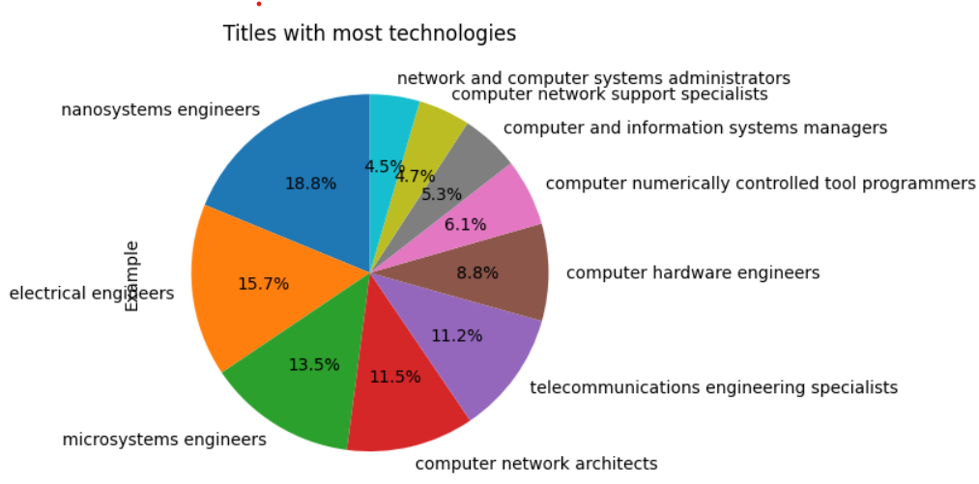
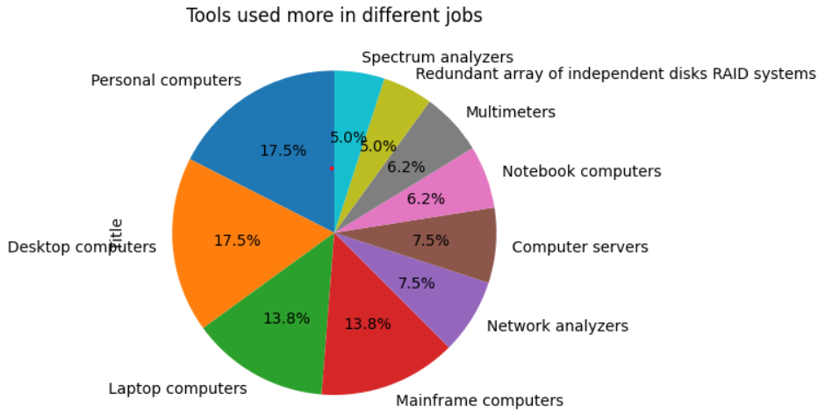

Slide 24
A distribution of tools
used
among different jobs

Slide 25
A comparison between
different jobs
related with the tools they
require

Slide 26
Conclusions
(tools used)
- Specialized tools play a crucial role in professions like Nano-system Engineers, Electrical Engineers, and Microsystem Engineers.
- Nano-system Engineers, in particular, rely on a diverse set of tools such as Ashing systems, Atomic Absorption Spectrometers, and Atomic Force Microscopes, revealing the intricacies of their work.
- The distribution of tools among professionals emphasizes the importance of Personal Computers, Desktop Computers, Laptop Computers, and Mainframe Computers.

Slide 27
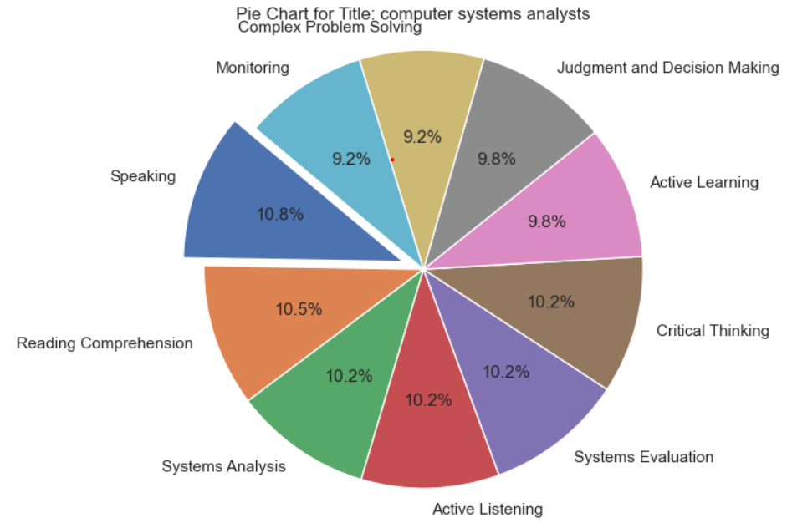
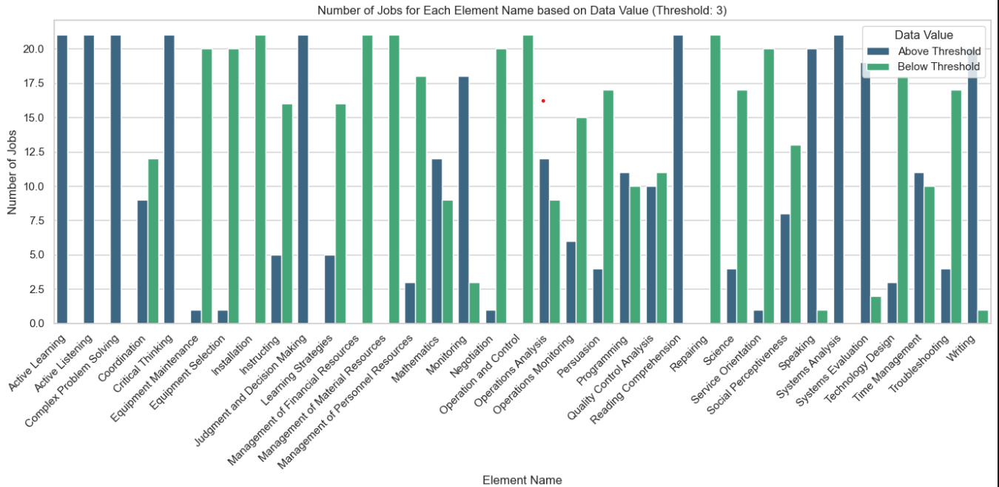
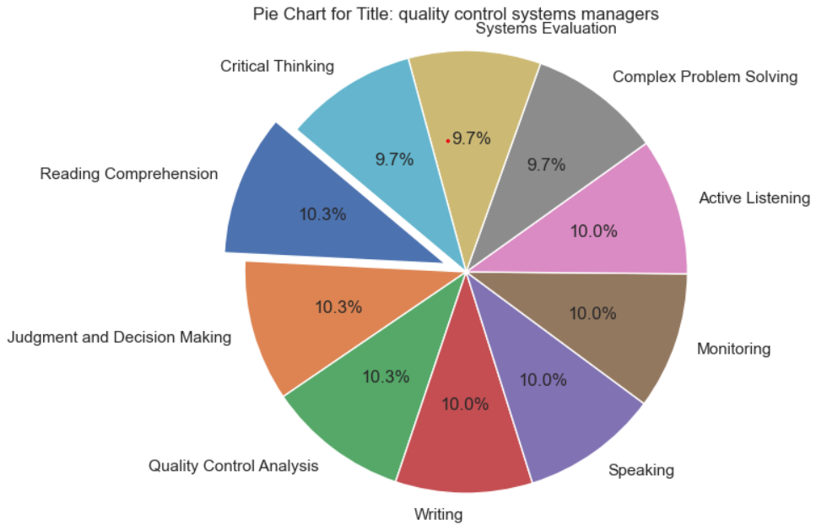
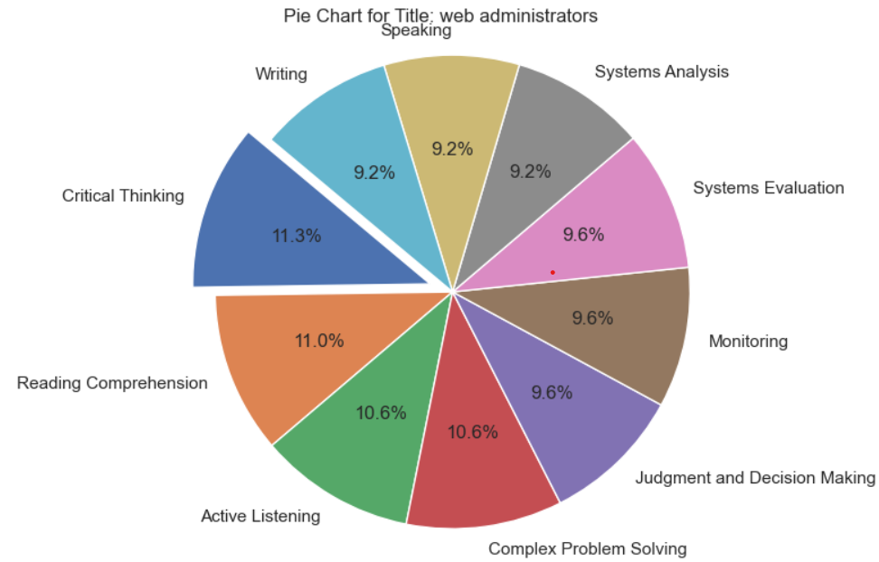

Slide 28
Third Question
Visualization of
non-practical skills
among all the jobs

Slide 29
Distribution of non-technical
skills for
Computer system analysts

Slide 30
Distribution of non-technical
skills for
Quality Control System
analysts

Slide 31
Distribution of non-technical
skills for
Web Administrators

Slide 32
Conclusion
Seven skills, including Active Learning and Complex
Problem Solving, show an 100% representation above
the threshold, while others, like Monitoring and Writing,
maintained significant 90/10 or 80/20 representations,
emphasizing their relevance in programming roles.

Slide 33
Models Used – all trained in the “Skills.xlsx”
Word2Vec, CBOW on stemmed dataset
Word2Vec, Skip-Gram on stemmed dataset
Word2Vec, CBOW on not-stemmed dataset
Word2Vec, Skip-Gram on non-stemmed dataset
Training time: 4.9s
Pair similarity: -0.52
Clusters: 2
Training time: 16.5s
Pair similarity: 0.06
Clusters: 3
Training time: 5.4s
Pair similarity: 0.01
Clusters: 2
Training time: 17.9s
Pair similarity: 0.77
Clusters: 3
01
02
03
04

Slide 34
Models Used – all trained in the “Skills.xlsx”
Word2Vec, CBOW on stemmed dataset
Training time: 4.9s
Pair similarity: -0.52
Clusters: 2
Word2Vec, Skip-Gram on stemmed dataset
Word2Vec, CBOW on not-stemmed dataset
Word2Vec, Skip-Gram on non-stemmed dataset
Training time: 16.5s
Pair similarity: 0.06
Clusters: 3
Training time: 5.4s
Pair similarity: 0.01
Clusters: 2
Training time: 17.9s
Pair similarity: 0.77
Clusters: 3
01
02
03
04

Slide 35
Models Used – all trained in the “Skills.xlsx”
Word2Vec, Skip-Gram on stemmed dataset
Training time: 16.5s
Pair similarity: 0.06
Clusters: 3
Word2Vec, CBOW on stemmed dataset
Word2Vec, CBOW on not-stemmed dataset
Word2Vec, Skip-Gram on non-stemmed dataset
Training time: 4.9s
Pair similarity: -0.52
Clusters: 2
Training time: 5.4s
Pair similarity: 0.01
Clusters: 2
Training time: 17.9s
Pair similarity: 0.77
Clusters: 3
01
02
03
04

Slide 36
Models Used – all trained in the “Skills.xlsx”
Word2Vec, CBOW on not-stemmed dataset
Training time: 5.4s
Pair similarity: 0.01
Clusters: 2
Word2Vec, CBOW on stemmed dataset
Word2Vec, Skip-Gram on stemmed dataset
Word2Vec, Skip-Gram on non-stemmed dataset
Training time: 4.9s
Pair similarity: -0.52
Clusters: 2
Training time: 16.5s
Pair similarity: 0.06
Clusters: 3
Training time: 17.9s
Pair similarity: 0.77
Clusters: 3
01
02
03
04

Slide 37
Models Used – all trained in the “Skills.xlsx”
Word2Vec, Skip-Gram on non-stemmed dataset
Training time: 17.9s
Pair similarity: 0.77
Clusters: 3
Word2Vec, CBOW on stemmed dataset
Word2Vec, Skip-Gram on stemmed dataset
Word2Vec, CBOW on not-stemmed dataset
Training time: 4.9s
Pair similarity: -0.52
Clusters: 2
Training time: 16.5s
Pair similarity: 0.06
Clusters: 3
Training time: 5.4s
Pair similarity: 0.01
Clusters: 2
01
02
03
04

Slide 38
All the models have those in common:
Number of epochs (10)
Window size (10)
Minimal count (2)
Vector size (100)
On each model was applied:
PCA method (for dimensionality reduction)
Kmeans (for clustering)
Plotly library (for visualization)

Slide 39
All the models have those in common:
Number of epochs (10)
Window size (10)
Minimal count (2)
Vector size (100)
On each model was applied:
PCA method (for dimensionality reduction)
Kmeans (for clustering)
Plotly library (for visualization)

Slide 40
All the models have those in common:
Number of epochs (10)
Window size (10)
Minimal count (2)
Vector size (100)
On each model was applied:
PCA method (for dimensionality reduction)
Kmeans (for clustering)
Plotly library (for visualization)

Slide 41
All the models have those in common:
Number of epochs (10)
Window size (10)
Minimal count (2)
Vector size (100)
On each model was applied:
PCA method (for dimensionality reduction)
Kmeans (for clustering)
Plotly library (for visualization)

Slide 42
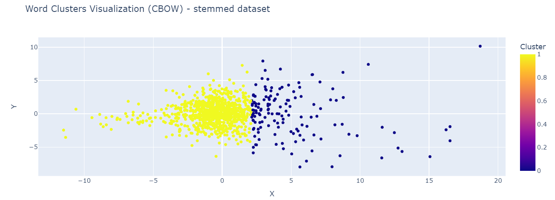
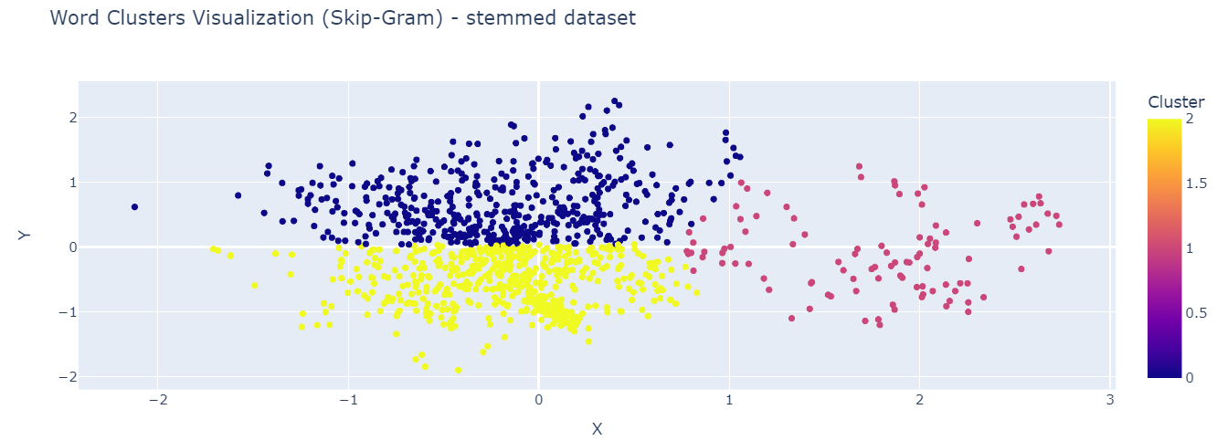
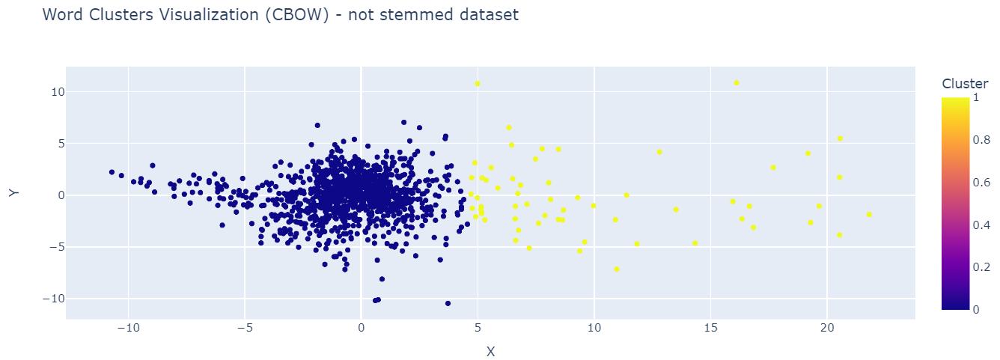
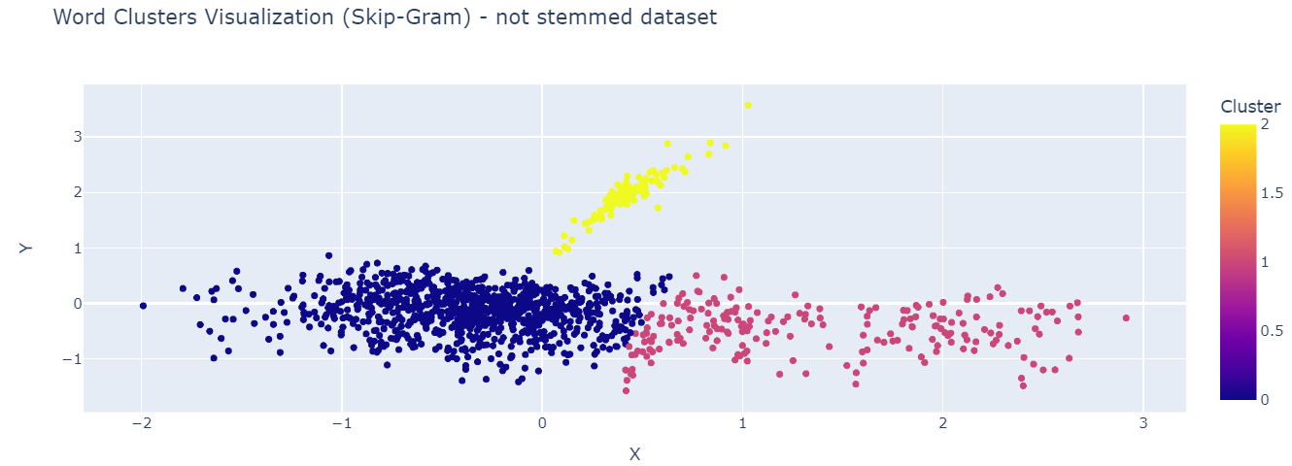
Unbalanced clusters
Representing CBOW having issues
capturing semantic relationships
between words/concepts

Slide 43
More smoothly separation
of datapoints between clusters
Cluster 1 gathering datapoints
with distinct semantic contexts

Slide 44
Cluster 0 represented as a
more concise indicating a
stronger idea that is present
among these words

Slide 45
The only model that fully separates one cluster
Algorithm has managed to capture distinct semantic
patterns across the data

Slide 46
Conclusions
CBOW models, applied to both stemmed and non-stemmed datasets, face challenges in capturing nuanced semantic
relationships, resulting in disparities in expected word pairings.
Skip-Gram models, especially on the non-stemmed dataset, performs good in capturing semantic relationships,
as evidenced by improved similarity scores and more cohesive cluster structures.
The positive outcome with the word pair 'web' and 'developers' underscores the Skip-Gram model's adeptness
at grasping subtle nuances in word associations.
The Skip-Gram model on the non-stemmed dataset proves particularly effective, showcasing its capability to discern
nuanced semantic associations even with the constraints of a not-so-large dataset.

Slide 47
sentence-transformers/all-MiniLM-L12-v2
Pre-trained on 1b sentences
Fine-tuned with cosine similarity between each pair of sentences in corpus
Corpus has sentences from more than 31 datasets including (reddit comments, simple Wikipedia, WikiAnswers etc)
384 dimensional vector space
Useful for clustering
3 well separated clusters
Pre-trained Model
05

Slide 48
sentence-transformers/all-MiniLM-L12-v2
Pre-trained on 1b sentences
Fine-tuned with cosine similarity between each pair of sentences in corpus
Corpus has sentences from more than 31 datasets including (reddit comments, simple Wikipedia, WikiAnswers etc)
384 dimensional vector space
Useful for clustering
3 well separated clusters
Pre-trained Model
05

Slide 49
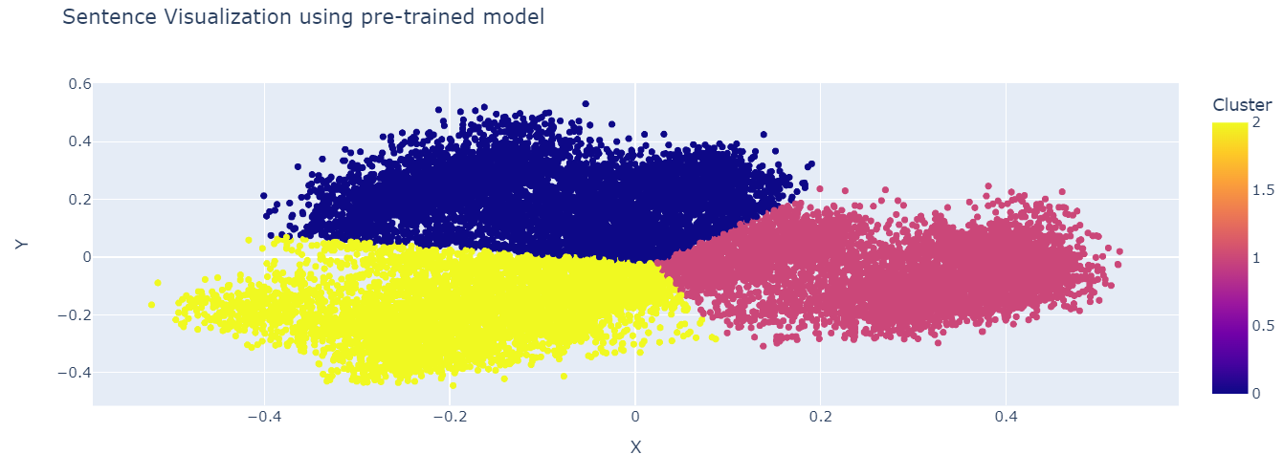
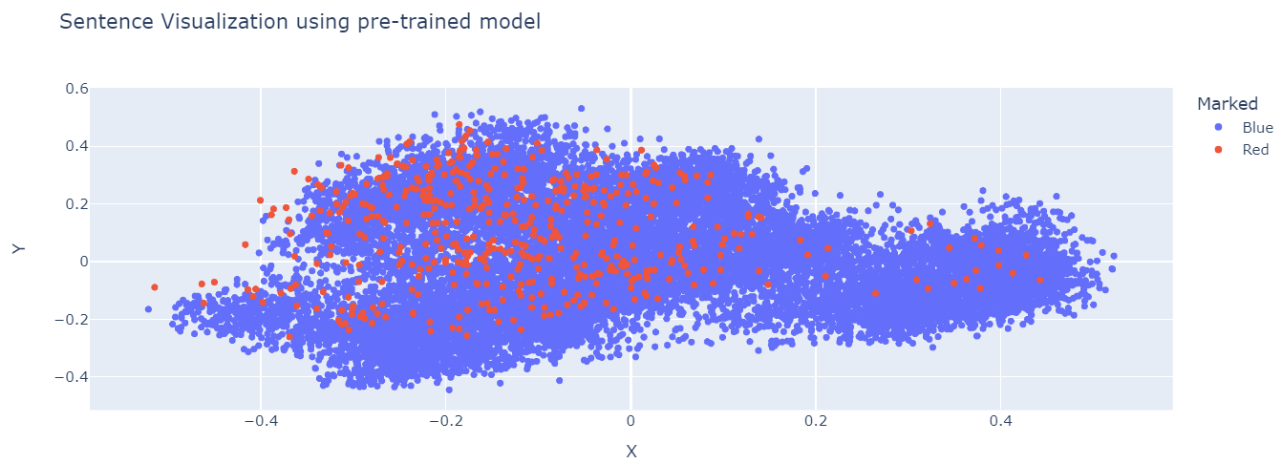
Phrases in each cluster have similar
semantic properties resulting in clearly
defined clusters

Slide 50
Using a list of phrases related to programming jobs
Using the cosine similarity to measure the similarity of each sentence
with this list of phrases
Using a threshold to depict the most relevant sentences
Visualization of the
sentences related to
programming among
all the sentences
in the corpus

Slide 51
Here my presentation comes to an end…

Slide 52

I wanted to express my
gratitude to my mentor, Alberto Caroli for his guidance, support, and insights throughout this project!

Slide 53


Thank you for your time!

